Slide 1


Call for Designs
SecKC DC27 Badge - CFD

Slide 2

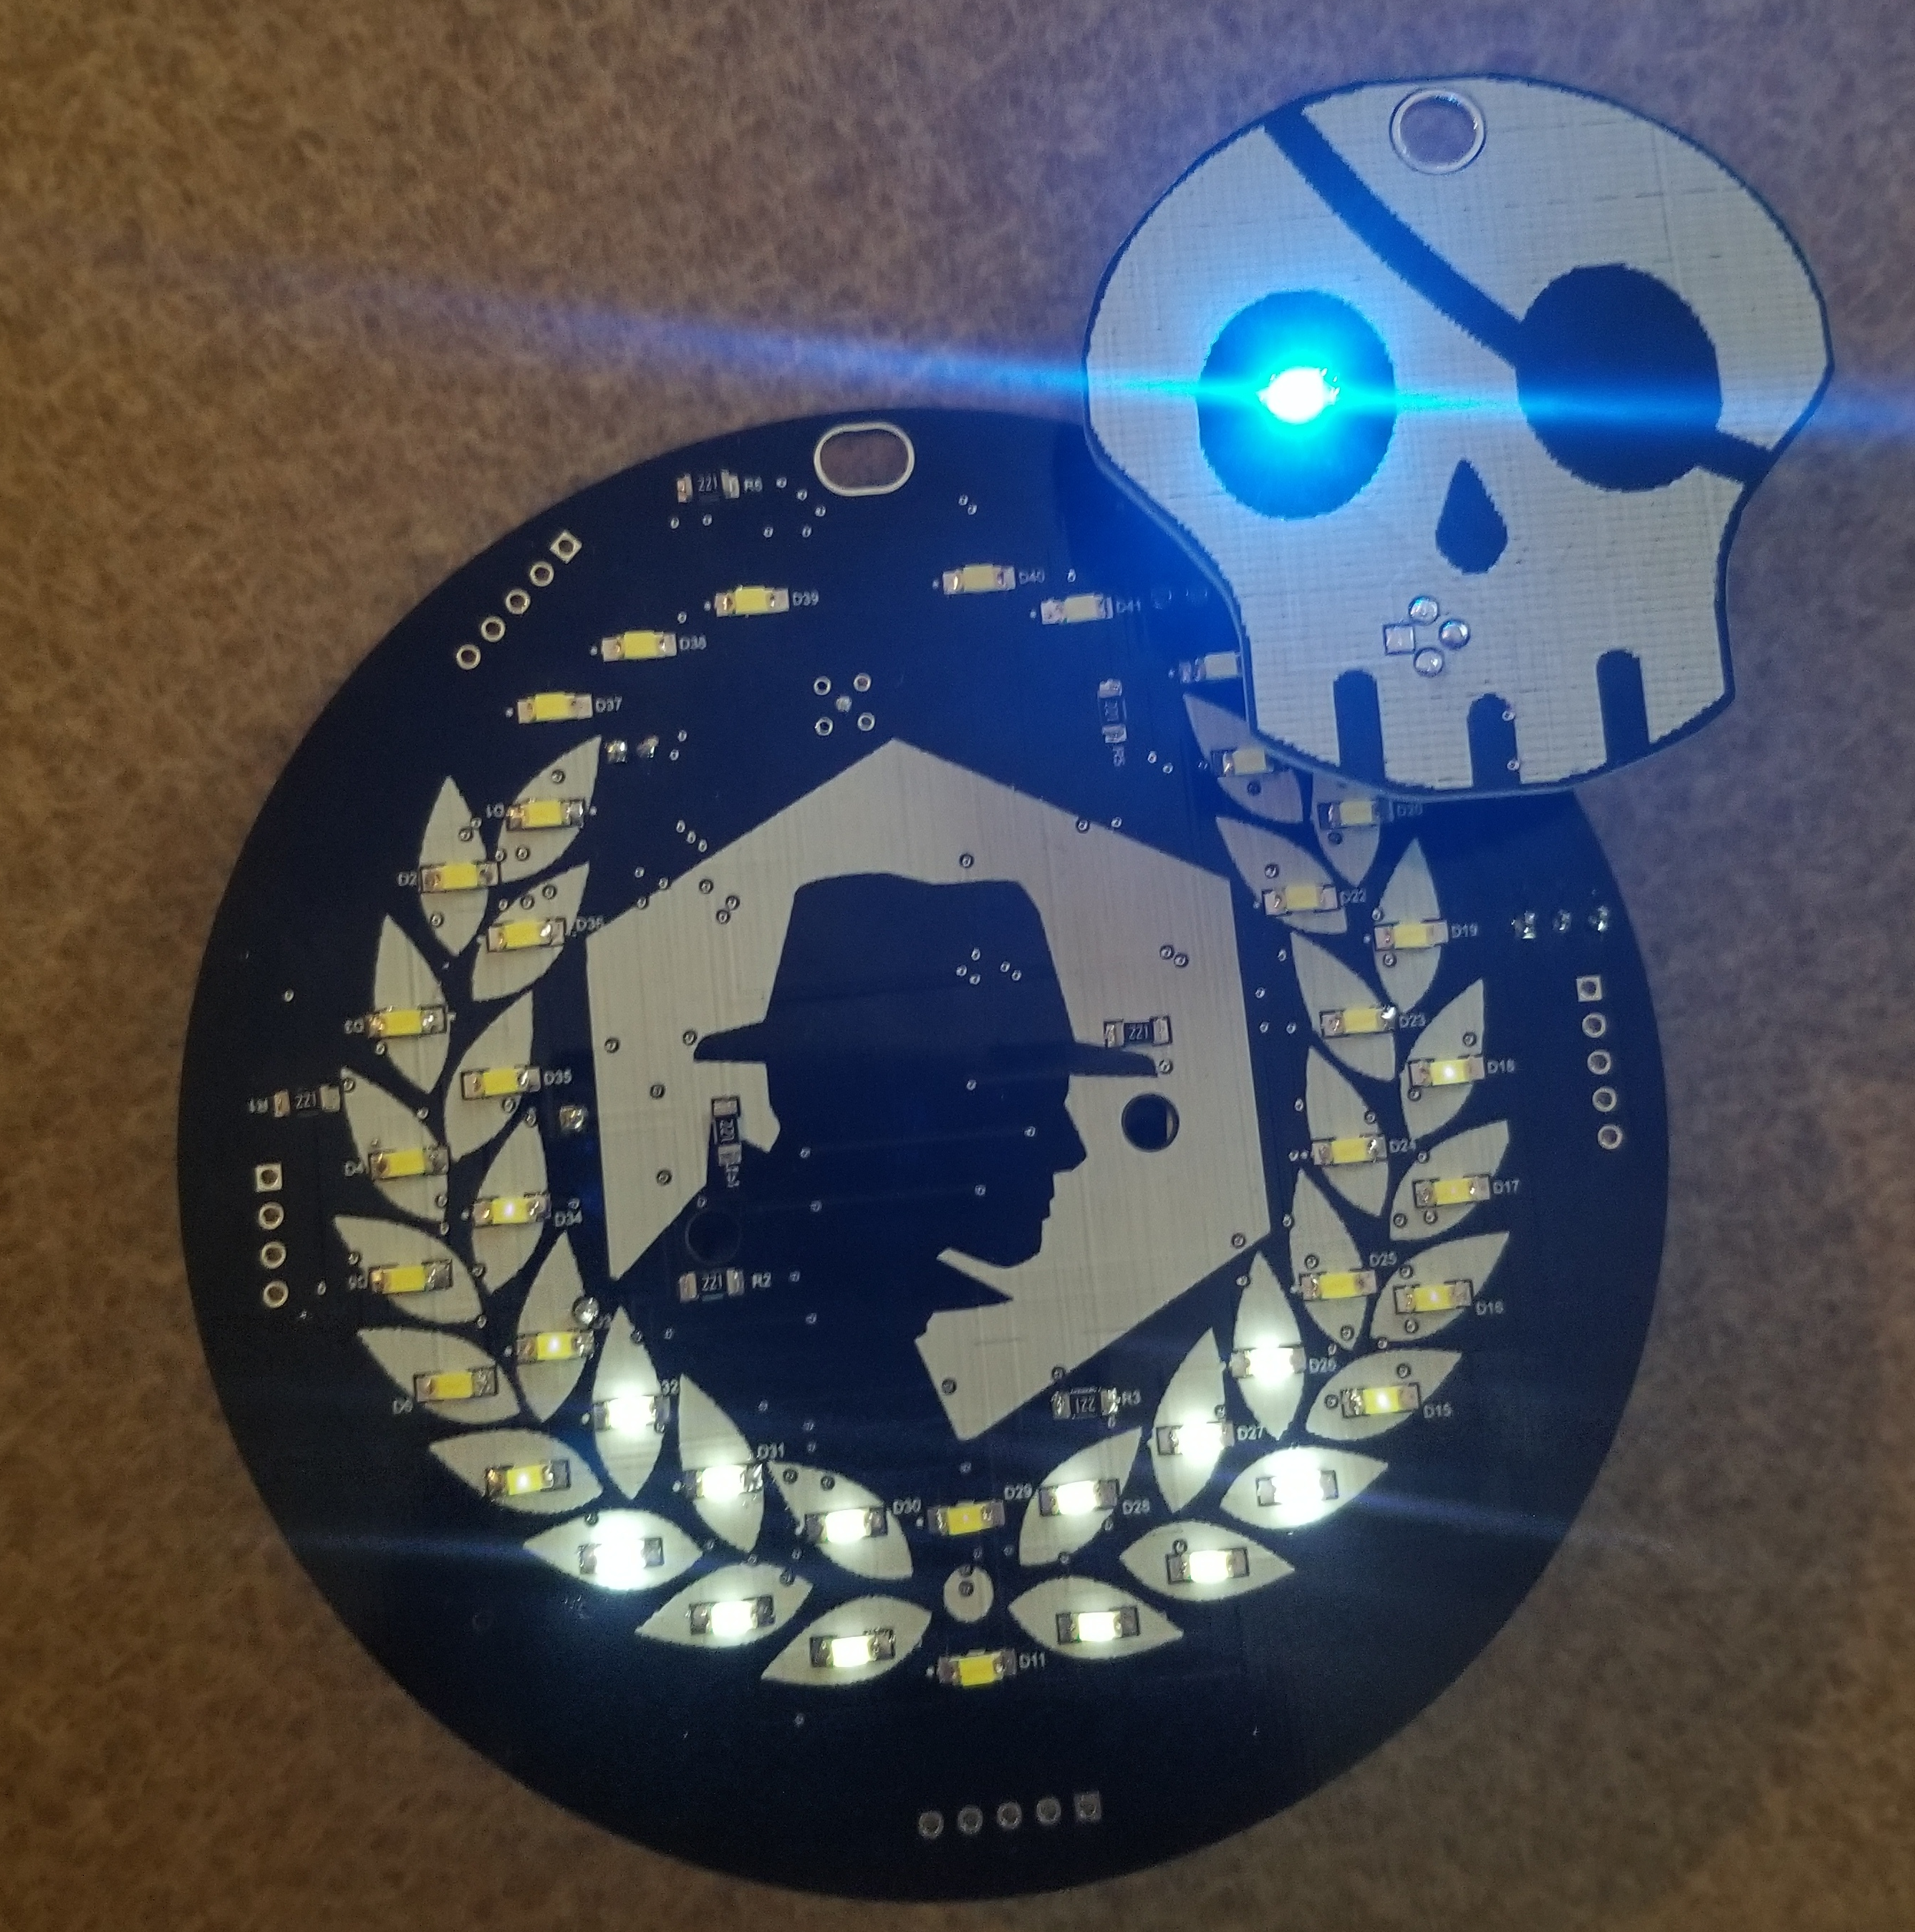
ABOUT US
Badge Pirates
Building Badges for Fun no Profit

Slide 3
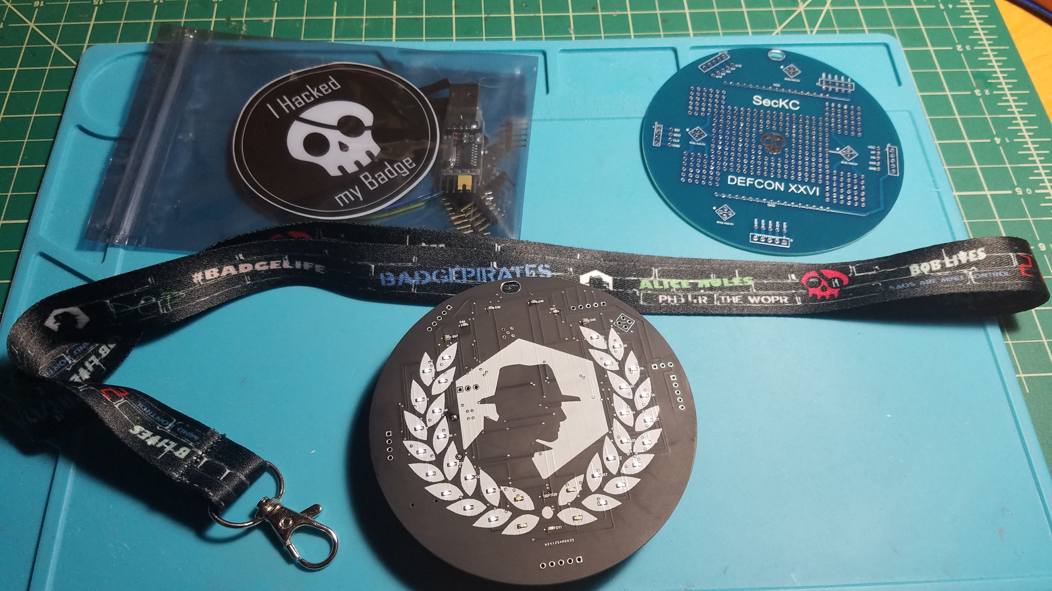
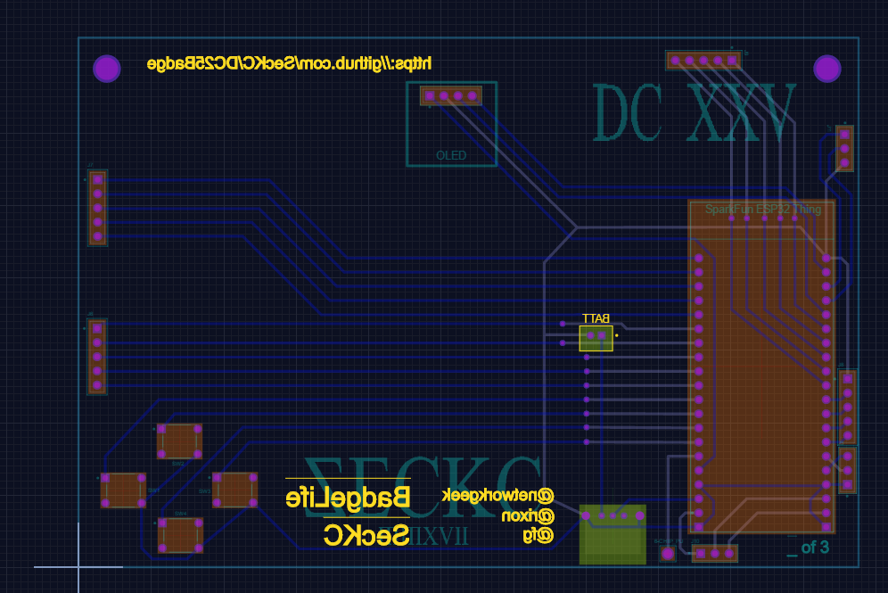
PROBLEM
Ideas?
We want to crowd source a design to the group
This is your badge
We will use the ESP platform, ESP32
Use same theory as last 2 years, an addon Board to hack

Slide 4
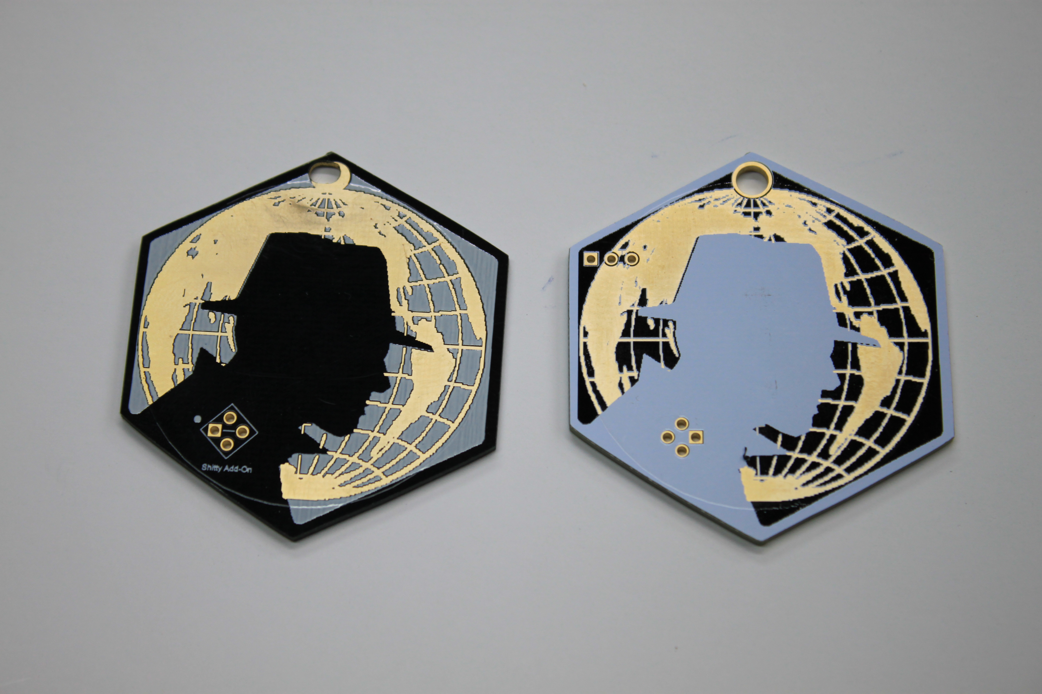
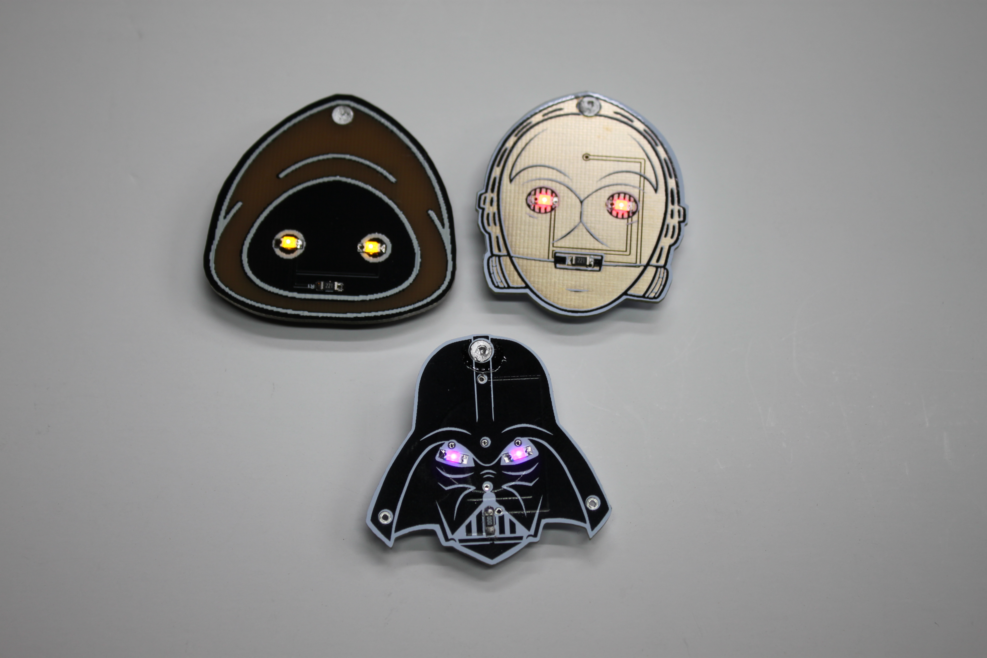
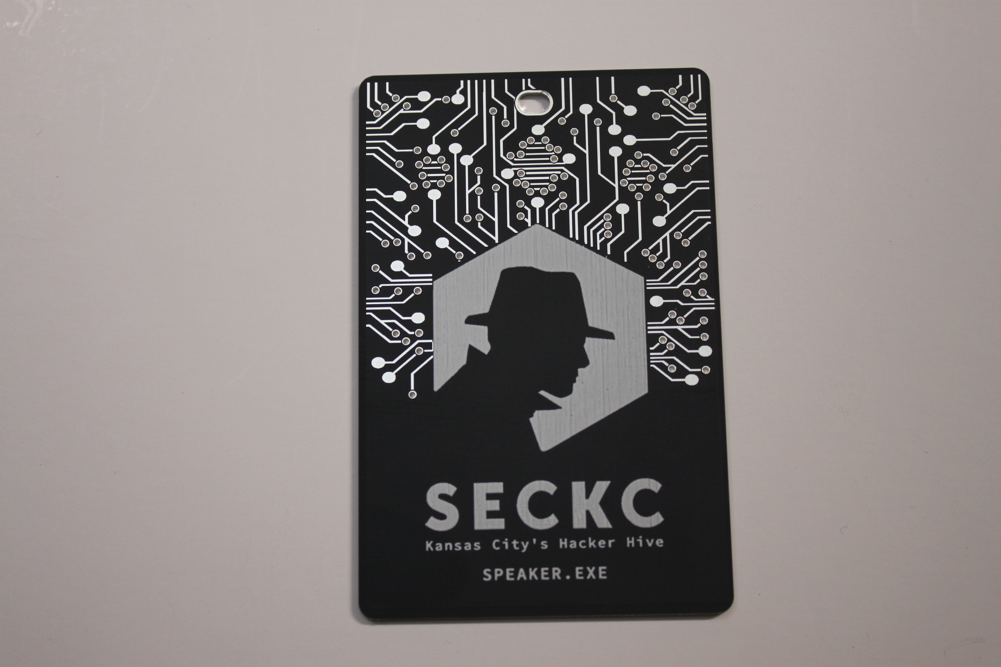

Slide 5

SOLUTION
Lets Brainstorm
Join the #Defcon27-Badge Channel
Show up Saturday for the Session, Johnson County Library, Carmack Room – 9 to 10:30

Slide 6


Constraints
What are our limits
Colors
Colors will be 2 with, 3 if we use Solder Layer, 4 if we use default board color
Size
Ideally somewhere around 100mm x 100mm

Slide 7

SUMMARY
Bring your Idea
We have little time, we will pick 3 ideas to test Saturday
Make this cool
Next steps function

Slide 8
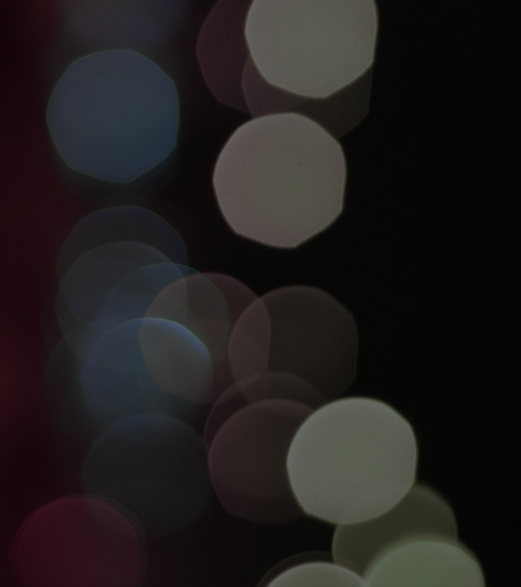
THANK YOU!
Kevin Bennett - FG
admin@badgepirates.com
Website:
http://www.badgepirates.com

